Slide 1
Closing the gap in an unequal society - a dream?
Roy Blatchford
www.blinks.education

Slide 2
Five Perspectives - 12.11.21
The gaps: Education Policy Institute
The Forgotten Third
Essex Education Task Force: equity and excellence
The world according to Marc Rowland!
A Language Collaborative: vocabulary, reading, oracy

Slide 3


Slide 4


Slide 5
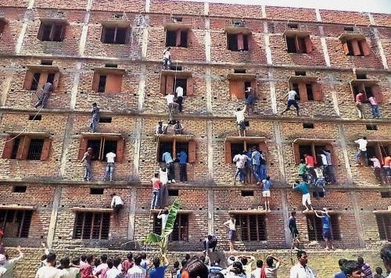

Slide 6
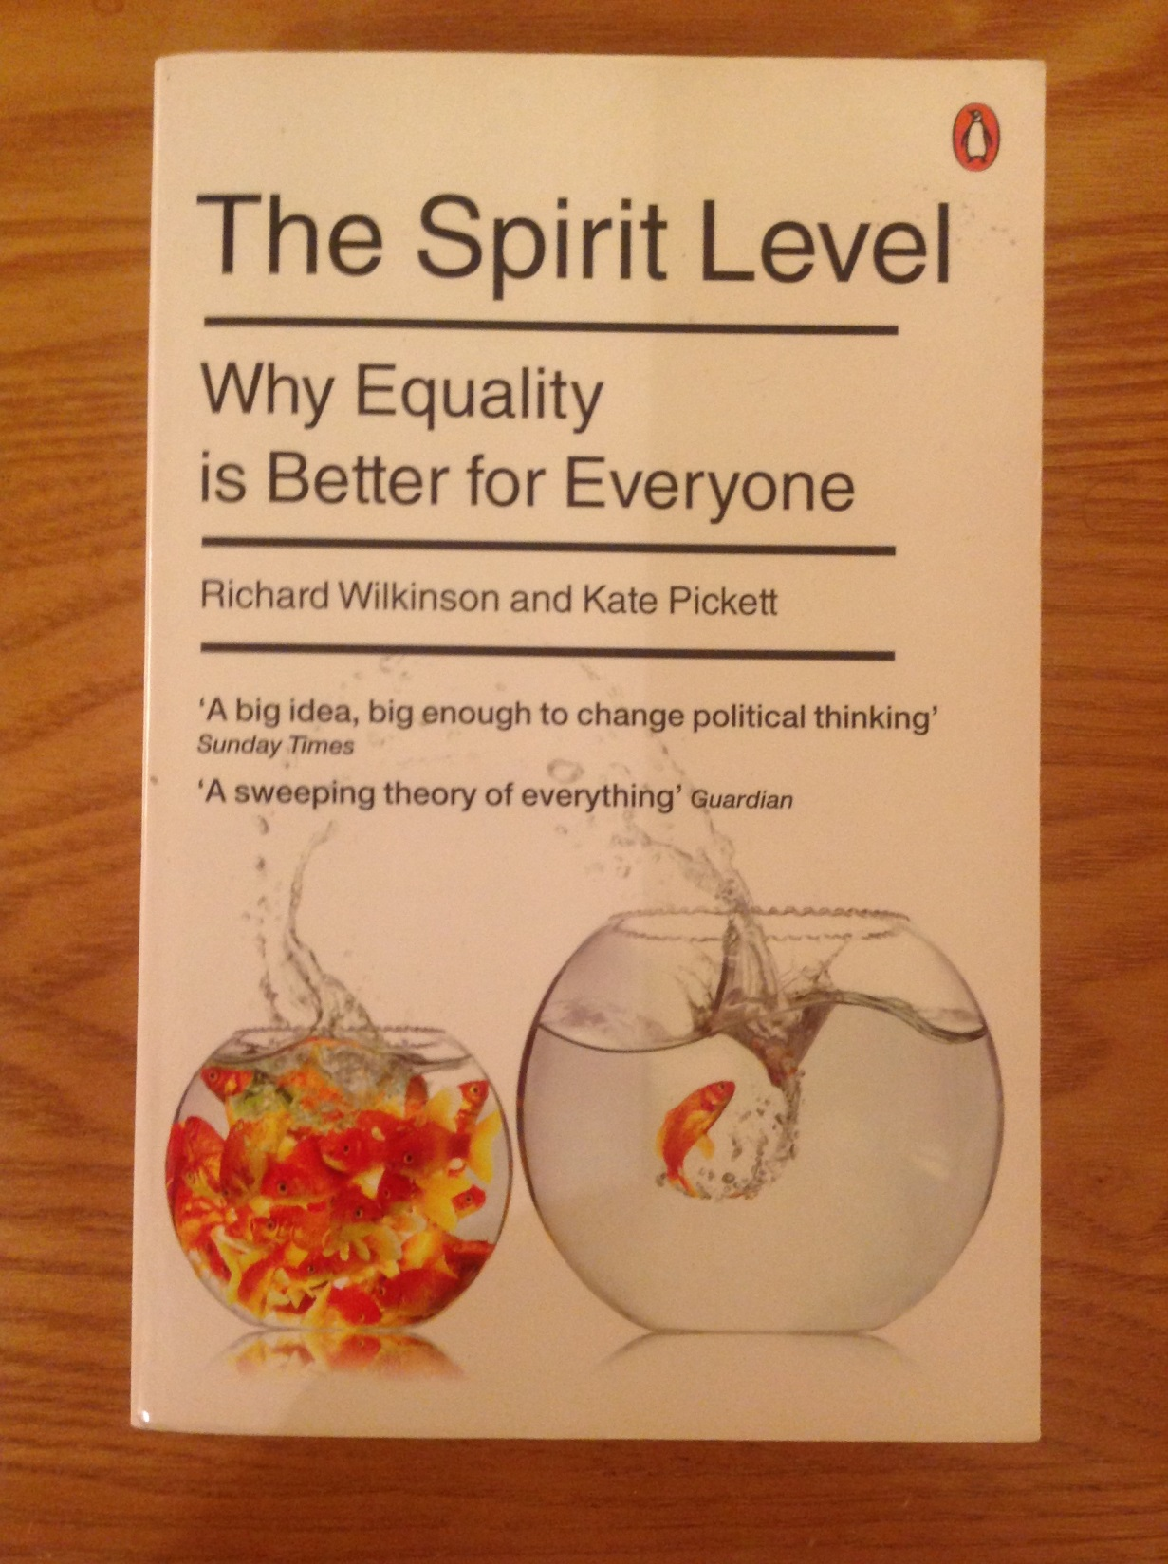

Slide 7
Top of the PISA league: maths, science, reading at 15
Finland
Canada
Japan
China
Singapore

Slide 8

CleverLands
CleverLands
Lucy Crehan
2016

Slide 9
High-Performing, Equitable Education Systems
1 Getting children ready for formal learning
2 Designing curricula contexts for mastery
3 Supporting children to take on challenges, rather than making concessions
4 Treating teachers as professionals
5 Combining school accountability with school support

Slide 10
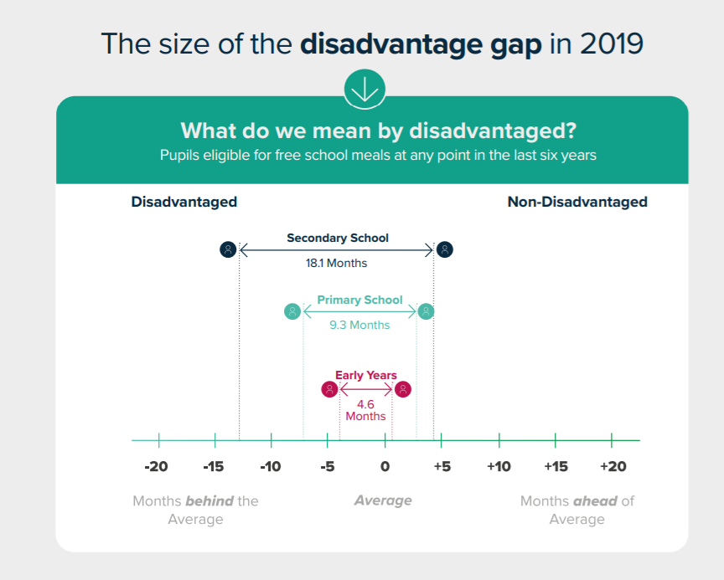
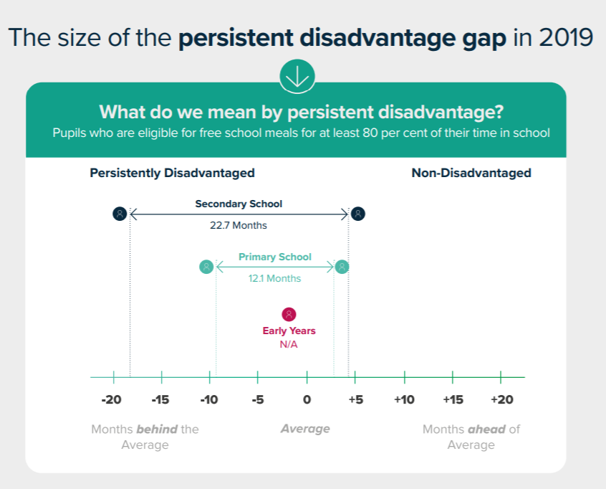

The gap at age 16 is equivalent to 18 months of development

Slide 11
By the end of secondary school, disadvantaged pupils are over 18 months behind their peers
The disadvantage gap refers to the difference in attainment between pupils eligible for the Pupil Premium and their peers.
This report is based on attainment data from summer 2019.
Disadvantaged children were, on average, 4.6 months behind their peers by age 5.
At the end of Key Stage 2, the gap was 9.3 months

Slide 12
For persistently disadvantaged pupils, the gap is much wider
Persistently disadvantaged pupils refers to the those who have been eligible for Free School Meals for 80% or longer of their school lives.
These pupils were over a year behind their non-disadvantaged peers by the end of Key Stage 2.

Slide 13
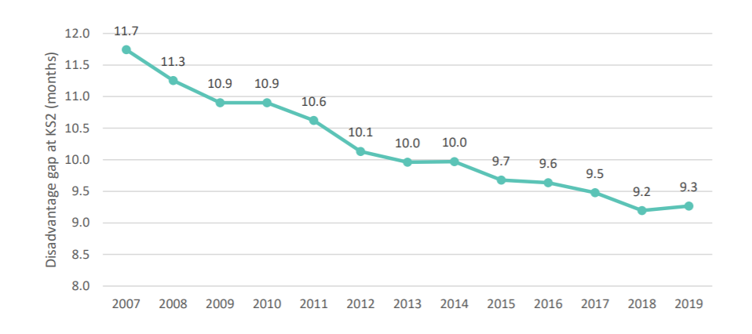
At all stages, the gap has stopped closing
Trends in the disadvantage gap in months at primary school
In 2018, the gap started to widen in the early years and in secondary school
In 2019, it started to also widen in primary school too (for the first time since 2007)

Slide 14
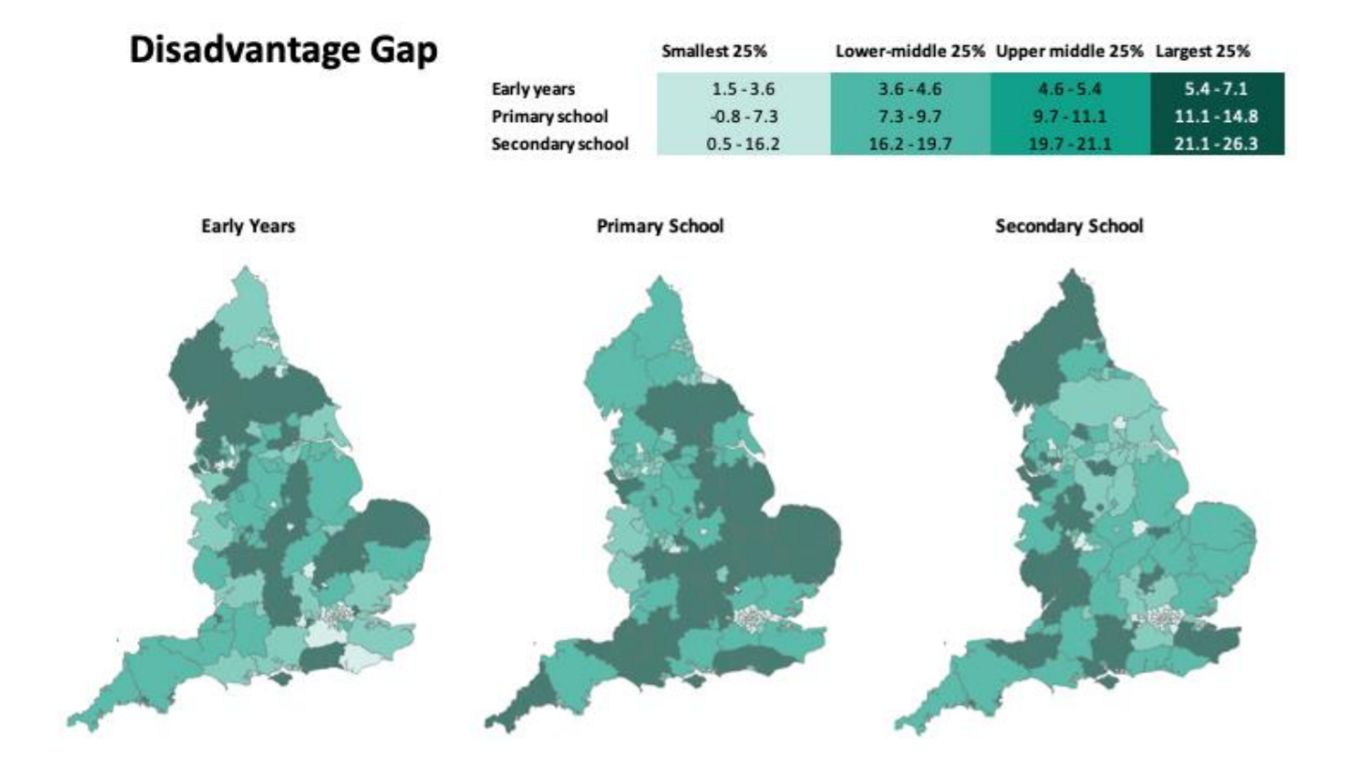
The disadvantage gap varies across the country as well as by phase
Regional variation in attainment is a well documented issue in England.
We find that the largest gaps in the early years are concentrated in the East, the Midlands and North-West.
In Primary, the largest gaps are in the East, Midlands and parts of the South West and the North.

Slide 15
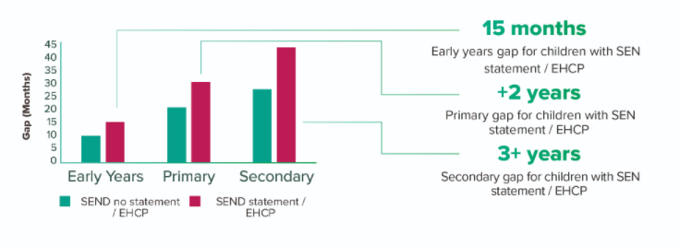
The gap is significantly wider for pupils with SEND
By age 5, children with an EHCP are around 15 months behind their peers
That gap is over two years at the end of Key Stage 2

Slide 16
What are some of the key drivers of the disadvantage gap?
Inequalities in child development and school readiness, determined by:
  Maternal health and well-being from conception onwards
  Family relationships, learning environment, and child-rearing strategies
  Access to high quality early years education, family and health services
Differential experiences of disadvantaged pupils in school:
  Quality of teaching and classroom practices
  Lacking belonging and self-esteem in relation to school, stereotyping and unconscious bias, and moving school at non-standard times
  Structural issues such as selection, grouping and the accountability system
Concentrated neighbourhood disadvantage:
  Poor housing conditions and local facilities
  Community poverty and exposure to crime

Slide 17
Existing evidence on raising the attainment of disadvantaged pupils
Promote an ethos of attainment for all pupils, rather than stereotyping disadvantaged pupils as a group with less potential to succeed.
Have an individualised approach to addressing barriers to learning and emotional support, at an early stage, rather than providing access to generic support and focusing on pupils nearing their end-of-key-stage assessments.
Focus on high quality teaching first rather than on bolt-on strategies and activities outside school hours.
Focus on outcomes for individual pupils rather than on providing strategies.
Deploy the best staff to support disadvantaged pupils; develop skills and roles of teachers and TAs rather than using additional staff who do not know the pupils well.
Make decisions based on data and respond to evidence, using frequent, rather than one-off assessment and decision points.
Have clear, responsive leadership: setting ever higher aspirations and devolving responsibility for raising attainment to all staff, rather than accepting low aspirations and variable performance.
Supporting the attainment of disadvantaged pupils: articulating success and good practice, Department for Education, November 2015

Slide 18
The Forgotten Third in England
190,000+ students in August 2019 failed to secure a grade 4 in English Language and mathematics (dubbed the 1,2,3-ers)
36% of the cohort of 16 year olds – ‘do a third have to fail so that two-thirds pass?’ Does this really mean a third cannot read and write?
36% at 11+ also failed in summer 2019 to meet national expectations in reading, writing and maths

Slide 19
The Forgotten Third: 3 questions for us all
Are there always a third of children and young people who cannot attain nationally expected standards?
Is that third baked into our system? (‘comparable outcomes’)
Can we do things differently with qualifications?

Slide 20
1. Early Years
The Department for Education, local authorities, and third-sector providers should continue to invest in high-quality support programmes for parents and carers, rooted in evidence-based models.
The government should extend the entitlement to 30 hours of free early education per week to all three to four-year-olds, and it should ensure the level of funding is sufficient to meet the cost of sustainable high-quality provision.
The government should work with local authorities and education providers to improve the skills of early years practitioners, working towards ensuring that every early education setting is graduate-led.

Slide 21
2. Curriculum and pedagogy
The Department for Education, local authorities, multi-academy trusts, school partnerships and schools should continue to invest in language programmes which are having a measurable impact on closing the language gap. And, where possible, should provide training in English for speakers of other languages (ESOL) techniques for all teachers and support staff.
As part of schools’ and colleges’ curriculum development, primary and secondary subject specialists should consider building into their planning the vocabulary that is needed to develop students’ competence in their subjects, and the opportunities to practise this vocabulary.
Primary and secondary schools should consider how to implement high-quality whole-school programmes which explicitly promote oracy and articulacy, and the essential stepping stones in reading and writing which underpin children’s learning in all subjects. This could have a special spotlight on the 10 – 12 age range, supported by Department for Education grant funding through the national English Hubs.
The Department for Education should commission a focused review of the English curriculum from Key Stage 1 to Key Stage 3, with a view to providing greater continuity between what is taught in primary and secondary schools, and encouraging secondary schools to build more effectively on the strong foundations laid in primary.

Slide 22
3. Teacher education
Professional development providers should be encouraged to run innovative courses for senior leaders on ‘language at the heart of the leader’s mission’ – promoting the concept that every teacher in every classroom is a teacher of the English language.
From September 2020, all primary and secondary teacher training programmes should include substantial courses on the teaching of reading, writing and oracy; ESOL teaching techniques; and developing teachers’ own skills as fluent and accurate writers.

Slide 23
4. Qualifications
A working group representing the Department for Education, Ofqual and the professional associations should be established to introduce a Passport in English to replace the current GCSE English Language. This highly respected qualification would be taken by all students ‘graduating’ from school/college into the workplace or higher education. The Passport should be criterion referenced, comprising online assessment, a portfolio of a student’s writing and a significant oracy component. The qualification could be taken at different levels between the ages of 15 and 19, ending the wasteful GCSE resit industry.
It is recommended that the Passport in English be certificated by a body with international standing, with employer approval and branding. It is also recommended that similar consideration be given to a companion Passport in Maths.
All students should continue to take GCSE English Literature as a core subject. To safeguard good curriculum breadth and students’ access to ‘the best that has been thought and said’, the examination should be taken at the end of Year 11 only.
A new approach to primary assessment and accountability should be developed to replace Key Stage 2 SATs, in order to redress the distorting effect on the curriculum of the current approach.
The Department for Education – supported by Ofqual – should no longer use the unhelpful terminology of ‘standard’ and ‘strong’ pass when announcing GCSE results to students, parents and the media. A grade is a grade.

Slide 24
Essex Education Task Force
Five key terms of reference: RENEWAL, EQUALITY, AMBITION
1. To ensure that no child or young person is 'left out or left behind' as the county builds a better future for all its residents. We need to listen regularly to children.
2. To have a focus on children and young people who have special education needs, those from disadvantaged backgrounds, and those who – with their families - have become more disadvantaged as a result of the pandemic.
3. To have an oversight that the Covid-19 impact on children and young people is being mitigated consistently throughout Essex.
4. To champion ‘equity, inclusion and excellence’ across the County’s education sectors, sharing the best practices, locally, regionally and nationally.
5. To embed system leadership and the habit of collaboration within the education sectors, powerfully linked to the County’s business, health, voluntary, social, arts and sports sectors.

Slide 25
Essex Education Task Force
£50K: Pre-school language – professional development.
£75K: ‘Transition coaches’: vulnerable students at 16+, moving into FE Colleges.
£100K: to voluntary sector to provide summer and future holiday outdoor learning/residentials for most vulnerable students and those with SEND.
£100K: ‘Transition coaches’ for vulnerable children and those with SEND in Year 6, moving from primary to secondary school.
£100K: Leaders and their well-being.
£160K: Teenage mental health and well-being.

Slide 26
Essex Education Task Force
£1 million investment in reading, with a focus on the primary/secondary transition years: Years 6/7. Links to Essex Year of Reading 2022.
Every Essex child a confident reader
Renewal: to support children and young people who have fallen behind with their reading over the past year.
Equality: to read confidently is the golden key to being a successful learner
Ambition: to ensure that every Essex child leaves school able to read at their age level or better.

Slide 27
Excellence is not an act but a habit (Aristotle)
High intention in practice means that leaders and teams at all levels set out high, specific ambitions in their respective domains.
Sincere effort means that all staff approach their daily and weekly tasks with a sincerity and commitment that is personally and professionally satisfying.
Intelligent execution means that all staff think intelligently and practically about the best ways to achieve their goals.

Slide 28


Slide 29


Slide 30


Slide 31
Marc Rowland - pupil premium champion
1. Don’t see disadvantage as a problem with the pupils; see it as a challenge and an opportunity for the school.
2. Address the pupil learning needs, not labels. Avoid automatic associations with low attainment and funding streams.
3. Focus on the things that are most impacting on the attainment of disadvantaged pupils: oral language, reading – especially language comprehension, foundations for numeracy. Think about the development of staff expertise to meet pupil need.
4. Focus on those things that are in your gift – don’t try to solve all of society’s problems.
5. It’s a slog – there is no magic trick out there. Relentlessly focus on the experiences of pupils in the classroom. Avoid over intervention.
6. Don’t talk about early intervention, act on early intervention.

Slide 32
A Language Collaborative
Students: embedding the dignity and positive self-esteem of being able to speak, read and write with fluency
Teachers: ‘every teacher is a teacher of the English language’ – made explicit in classrooms

Slide 33
Language Collaborative
Students’ literacy
Academic language
Oracy and articulacy
Fun and fundamentals

Slide 34
Language Collaborative
The three circles of English – Braj Kachru:
Inner Circle
Outer Circle
Expanding Circle

Slide 35
Language Collaborative
1921 George Sampson
1975 The Bullock Report
1998 National Literacy Strategy
Everything has been thought of before, the challenge is to think of it again.....

Slide 36
Language Collaborative
Let all teachers in the nation’s classrooms recommit themselves to being teachers of English.
Let all students be reminded that they are innate knowers of the English language – a global gift!
                end.

Slide 37
Teachers’ Standards (2012)
demonstrate an understanding of and take responsibility for promoting high standards of literacy, articulacy and the correct use of standard English, whatever the teacher’s specialist subject

Slide 38
Oracy Framework: now the masks are off, let every voice be heard........
See pack: Alumnis Oracy Framework
You can make a difference - Roddy Doyle!
‘We beat on, boats against the current, borne back ceaselessly into the past.’
RB. end.

